Slide 1
Internet Censorship and Online Speech Chapter 5: Circumventing Censorship
Nick Feamster University of Chicago

Slide 2
Technical Overview of Circumvention Techniques
Virtual Private Networks
Attacks: Privacy leaks from VPNs
Tor
Attacks: DNS leaks, traffic analysis, rogue exit nodes
Domain Fronting
Blocking domain fronting
Steganography
Attacks: “Parrot” attack
Decoy Routing

Slide 3
Internet Censorship and Online Speech Chapter 5.1: Virtual Private Networks
Nick Feamster University of Chicago

Slide 4



Circumventing Internet Censorship: Proxies
Not everyone can connect to all web servers
Many use proxy servers to circumvent censorship
Governments are getting more adept at detecting proxy servers
Proxy server (e.g., VPN)
Public Internet
Notes:
In this talk our goal is to answer how these governments find these proxies?

Slide 5
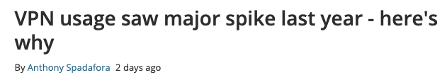
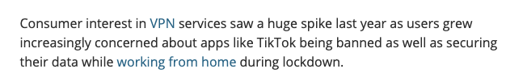
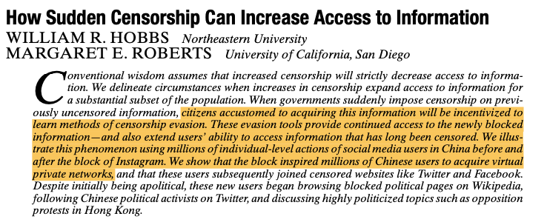

Slide 6
Privacy on Public Networks
Internet is designed as a public network
Routing information is public
IP packet headers identify source and destination
Even a passive observer can easily figure out who is talking to whom
Encryption does not hide identities
Encryption hides payload, but not routing headers
Even IP-level encryption (VPNs, tunnel-mode IPsec) reveals IP addresses of gateways

Slide 7
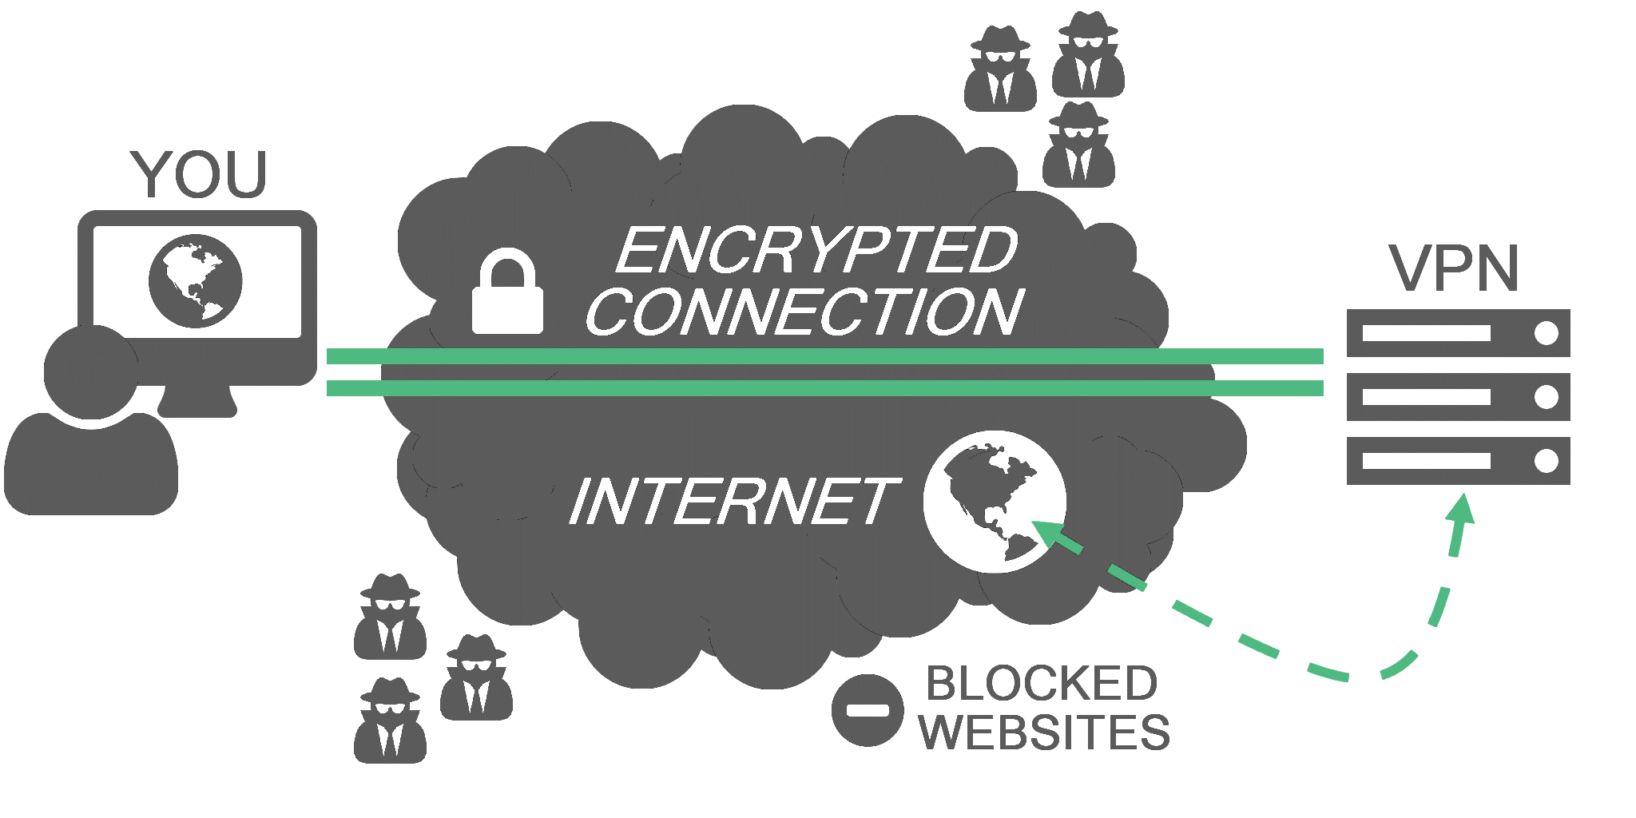
Virtual Private Networks (VPNs)
Encrypt and tunnel user’s traffic through proxy server.

Slide 8
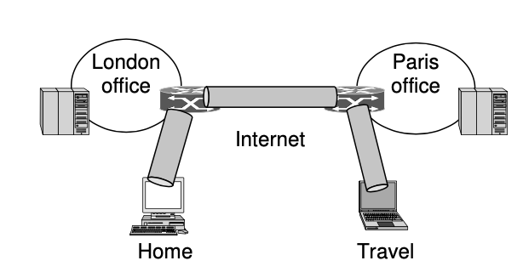
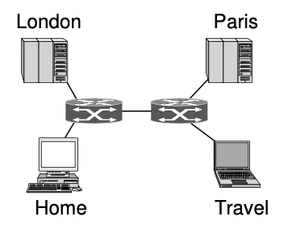
VPNs in Enterprise Networks

Slide 9
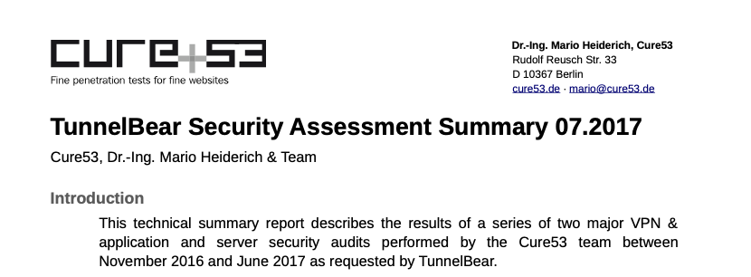
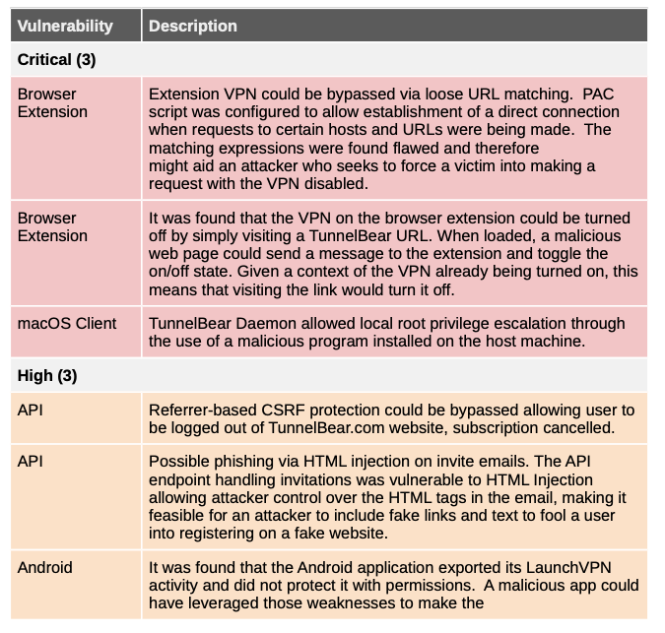
Not Always Secure…

Slide 10

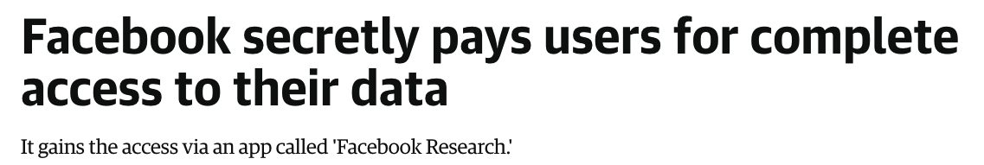

Not Always Private…
August 2018
January 2019
February 2019

Slide 11
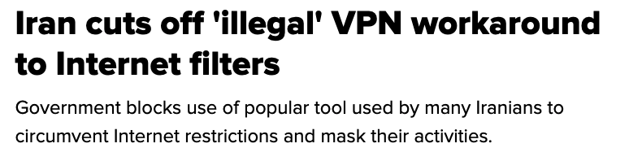

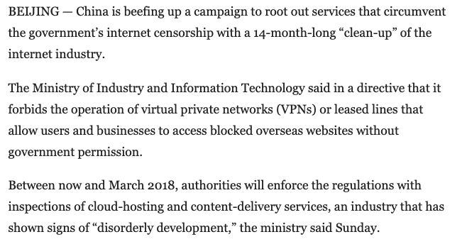
Not Always Functional or Allowed…

Slide 12
Summary
Virtual Private Networks (VPNs) have several purposes:
Virtual connectivity to an existing network (e.g., campus, enterprise)
Privacy (encrypted end-to-end tunnel)
Circumventing censorship/access control
Not a panacea!
Many VPNs are not secure or private!
VPNs themselves can be blocked

Slide 13



How and Why People Use Virtual Private Networks
Agnieszka Dutkowska-Żuk, Austin Hounsel∗, Amy Morrill† Andre Xiong∗, Marshini Chetty†, Nick Feamster†
Lancaster University, Princeton University∗, University of Chicago†
Notes:
Hello, my name is Agnieszka Dutkowska-Zuk, I am a PhD student at Lancaster University. today I will be talking about the work that my colleagues at Princeton University and the university of Chicago and I have worked on. As the title suggests, our goal was to understand how and why people useuse virtual private networks.

Slide 14


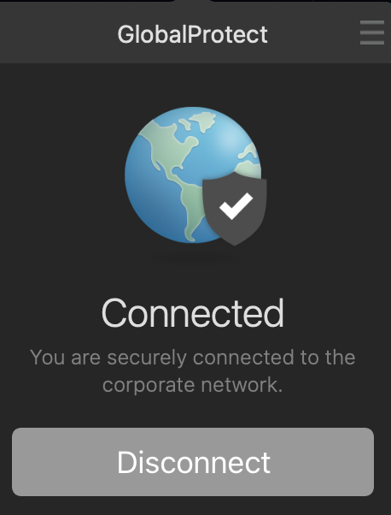


VPNs
Institutional
Commercial
e.g. Campus network for working off campus
Both free and paid
Notes:
Some of The most popular VPNs among our participants were Hotspotshield, Nord VPN

Slide 15


Commercial VPNs
Ultimate Security Package!
Free protection!
Keep your browsing private
Notes:
But do VPN users know about these risks?

Slide 16
Research Questions
Why do people use VPNs
Are people aware of the security & privacy risks of VPNs
How do people choose which VPNs to use

Slide 17
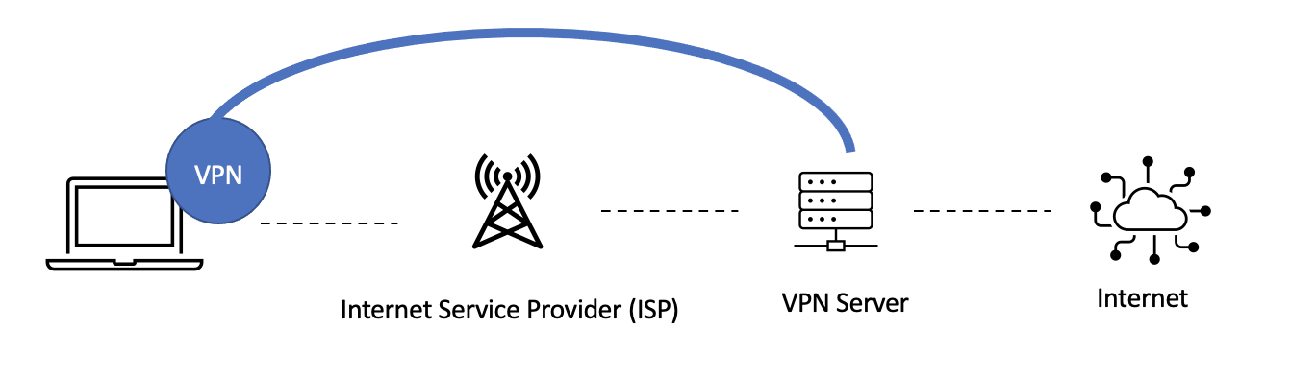



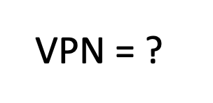

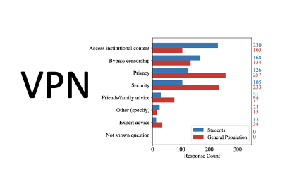






Introduction to VPNs
Methods
Findings
Implications
Conclusions
+
Plan
Notes:
This takes us to the methodology that we used.

Slide 18


Methods
729 U.S. VPN users
Interviews
Survey
32 Students
349 Students
+
348 General Population users on Prolific
342 U.S. 98%
6 International 2%
Notes:
almost all of the general population respondents were Americans.

Slide 19

Methods
729 U.S. VPN users
Interviews
Survey
32 Students
349 Students
+
348 General Population users on Prolific
Notes:
Let’s start with a quick summary of our semi-structured interviews:

Slide 20
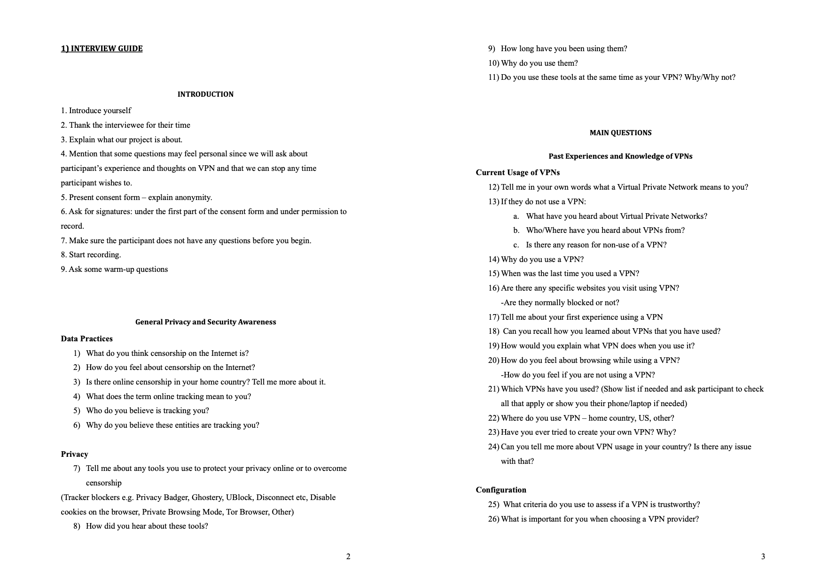
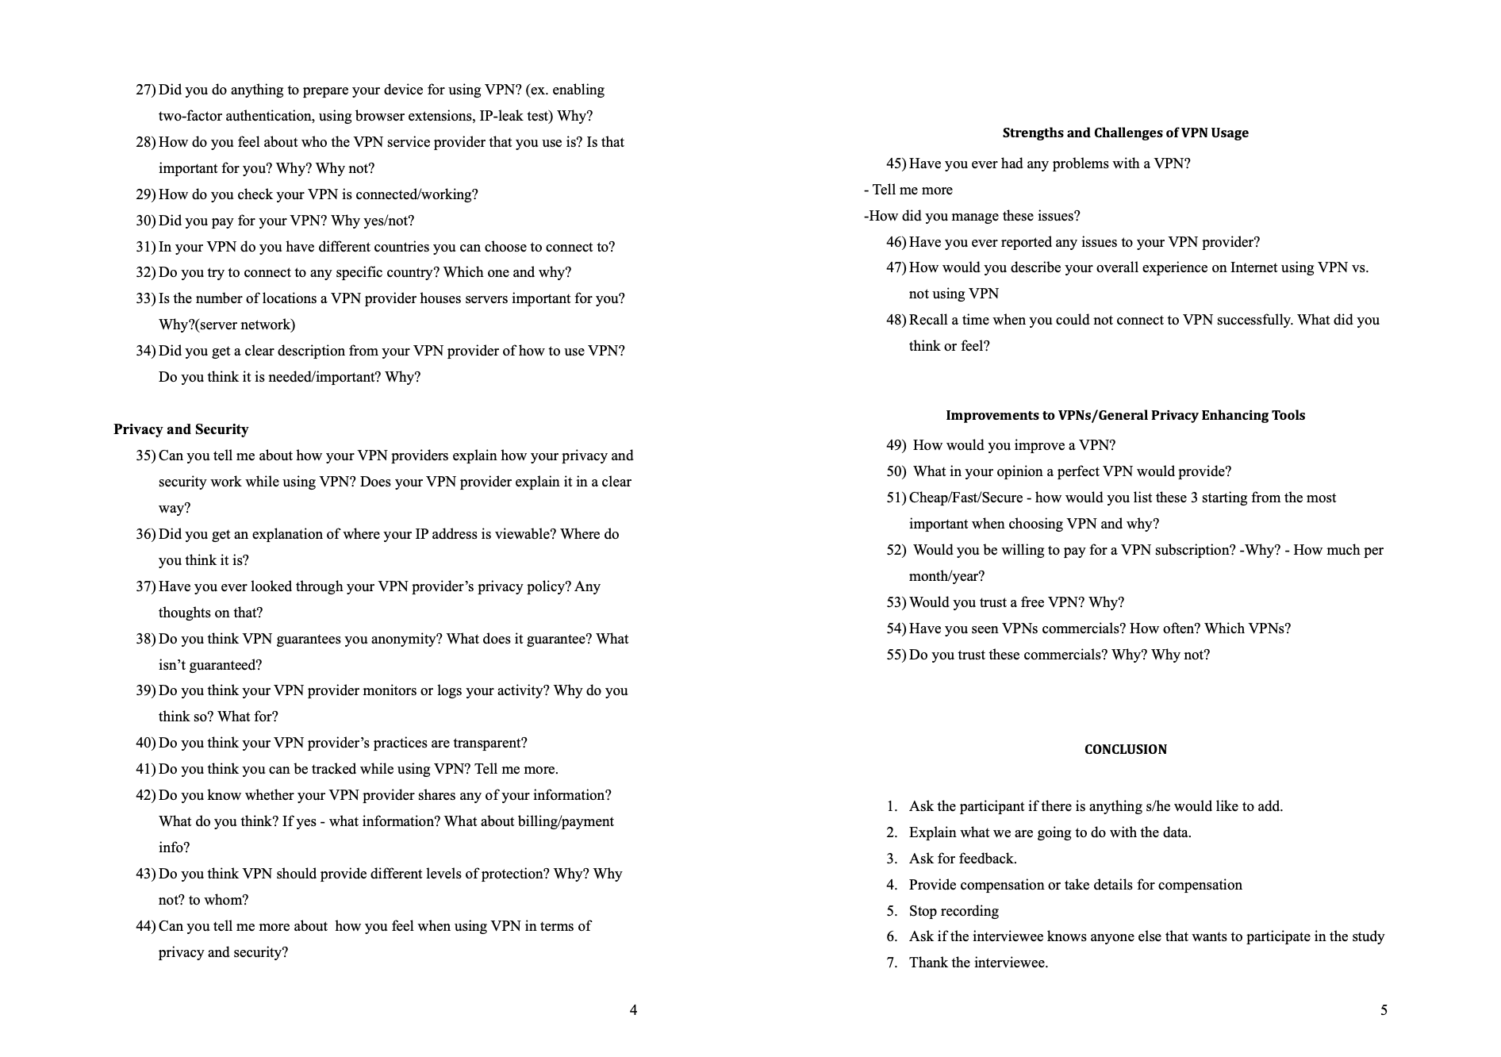
Interview Guide
Notes:
We first designed an interview guide which included questions about participants’ general privacy and security awareness about VPNs. We asked participants who they be- believed could collect data about them online, to describe, in their own words, how a VPN works. how they learned about VPNs and what their first experience using a VPN was. We also asked how participants choose and use a particular VPN and about likes, dislikes, and improvements concerning current VPNs;

Slide 21
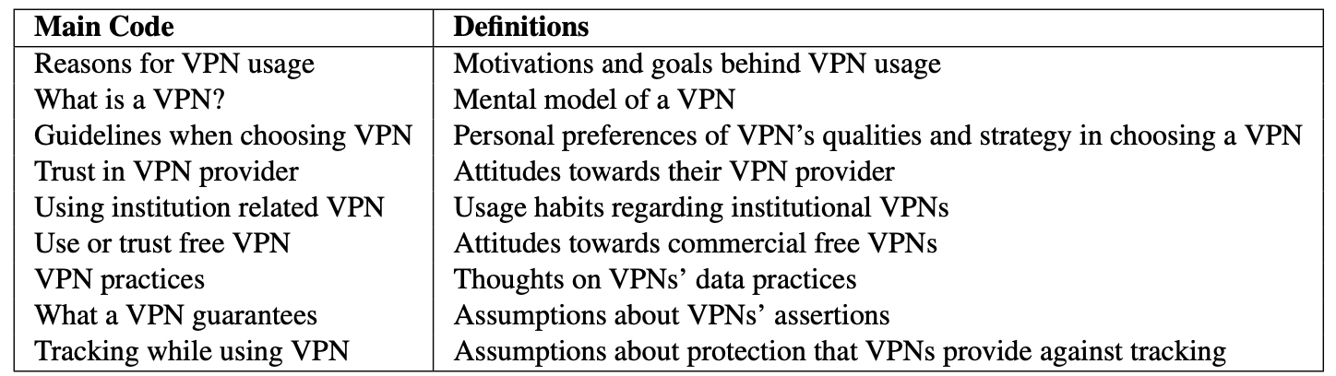
Data Analysis
Summary of main codes reported in the interviews coded in Dedoose
Notes:
We used Dedoose for coding and This is a summary of main codes that we report on in our paper.
We identified nine parent codes of interest, with 31 child codes reflecting the data's main themes.

Slide 22
Methods
Interviews
Survey
32 students
349 Students
+
348 General Population users on Prolific
Notes:
Based on interview data and analysis, we designed a larger scale study. We wanted to determine which themes from the interviews held with a larger sample of users, with differing technological knowledge, background and also access to VPNs. As I mentioned before first we run our study with the population of students from the same university as interview participants, and also, the general population on prolific. To analyze our data we used Qualtrics, R, and coded open-ended questions similarly to interviews.

Slide 23
Introduction to VPNs
Methods
Findings
Implications
Conclusions
+
Plan
Notes:
Now I will talk about our findings

Slide 24




Findings
VPN Usage
Mental Models of VPNs
VPN Selection
Notes:
I will talk about how our participants used VPNs, what they believed VPNs are and how they select VPNS

Slide 25
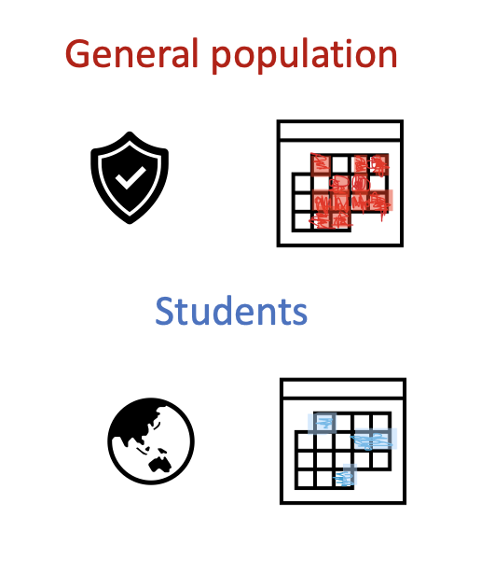
Findings
For privacy/security and continually
VPN Usage
To access content, when needed
Notes:
our main takeaways here are that: The general population uses VPNs more for secu- rity and privacy and tends to use VPNs continually. Students also valued these goals but tended to use VPNs more as a means to circumvent access controls.

Slide 26
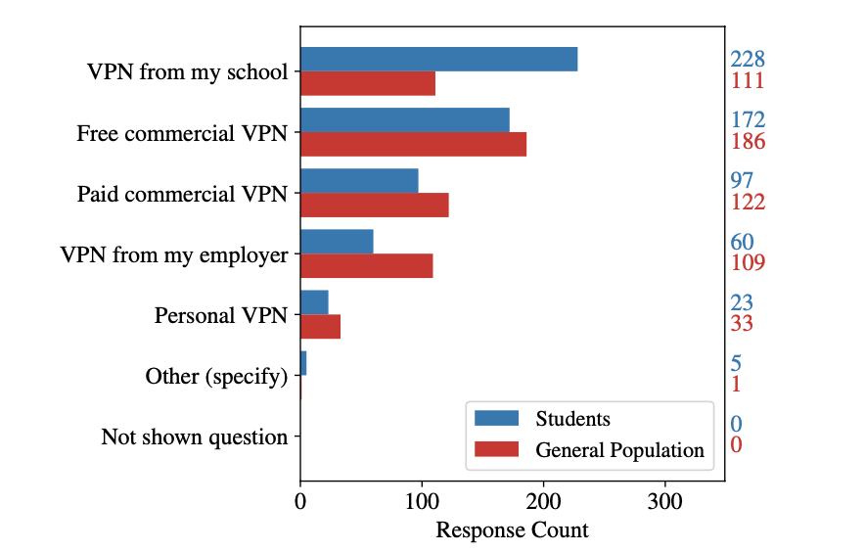
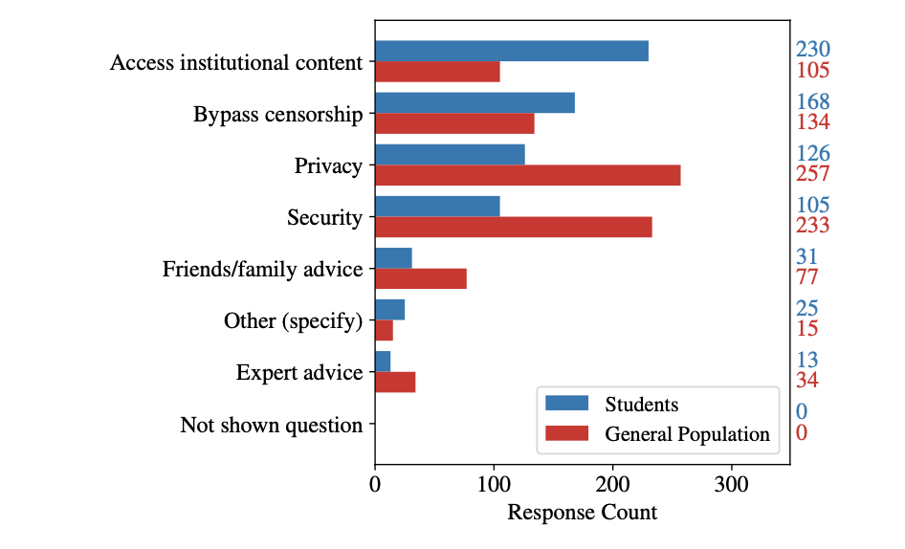
Findings:
Types of VPNs used (responses selected by participants)
Why do/did you use a VPN? (responses selected by participants)
Notes:
Let's look at the numbers now. If you look at the table on the left, we can see that most student respondents used the VPN offered by their university (228/349) and nearly half also used free commercial VPNs (172/349) .

Slide 27
Findings:
Types of VPNs used (responses selected by participants)
Why do/did you use a VPN? (responses selected by participants)
Notes:
They reported using it to access institutional content and bypassing censorship.

Slide 28
Findings:
Types of VPNs used (responses selected by participants)
Why do/did you use a VPN? (responses selected by participants)
Notes:
Most general population VPN respon- dents used free commercial VPNs (186/348), while paid com- mercial VPNs (122/348) and institutional VPNS were less popular.

Slide 29
Findings:
Types of VPNs used (responses selected by participants)
Why do/did you use a VPN? (responses selected by participants)
Notes:
They mostly used it for privacy and security

Slide 30
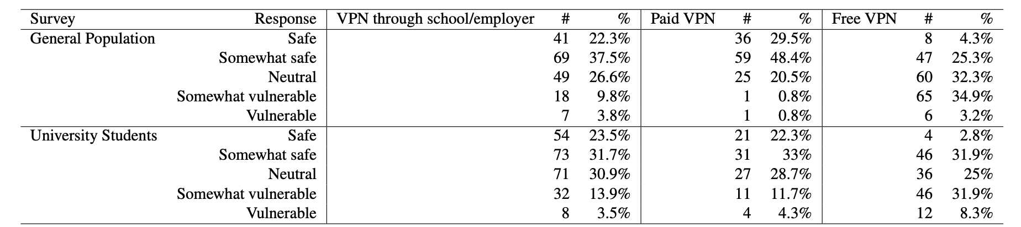
Findings:
Notes:
Interestingly, as shown in the table here, Both groups felt safest using institutional VPNS, not commercial VPNS.

Slide 31

Findings:
Students:
Sometimes or rarely: 302 /349
General population:
Sometimes: 164/348
Most of the time: 91/348.
How often do you use VPNs?
Notes:
There is a difference between these two groups in how often they used VPNs. 302 students /reported only using a VPN sometimes or rarely.
While Most General population respondents re- ported using VPNs sometimes and most of the time

Slide 32


Findings
VPN Usage
Mental Models of VPNs
VPN Selection
Notes:
Now I will talk about mental models of VPNs

Slide 33




Findings
VPNs collect data
Pragmatic approach
Mental Models of VPNs
Notes:
and our maintakakewaways here are that Most participants be- lieved VPNs collect data about them as a default consequence of using these tools, primarily for targeted adver- tising and also that our participants had pragramtic approach towards VPNs, and they rather knew what they are for rather than what they do exactly.

Slide 34
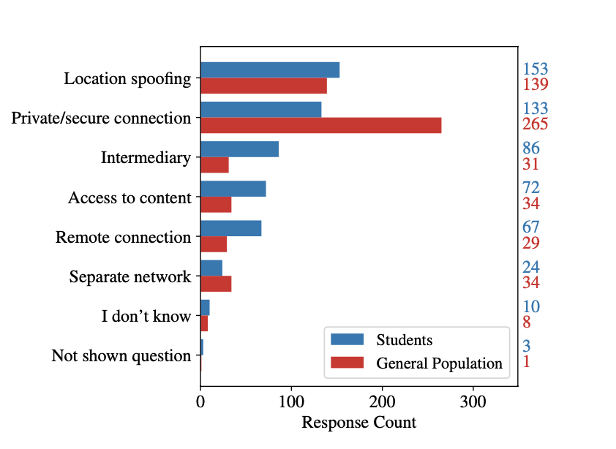
Findings:
What do you think a VPN is? (response coded by researchers)
Notes:
We asked participants to tell us what a VPN is in their own words. Here are coded responses from our surveys suggested that when thinking about VPNS participants focu, as i mentioned before, on the purpose of the VPN, such as location spoofing or providing extra security and privacy over the Internet.

Slide 35

Findings:
it’s like, “I need to see this YouTube video, but they don’t let me see it in Brazil so I’m just going to do it in Belgium.” I think that that’s what VPNs are to me.
P25
What do you think a VPN is? (response coded by researchers)
Notes:
We’ve seen similar pragmatic approach in our interview respondents, for example, P25 said:

Slide 36
Findings:
What do you think a VPN is? (response coded by researchers)
Notes:
Even though general population thought about VPNs as private/secure connection

Slide 37
Findings:
230/348 of General Population believed VPNs collect data about users
What do you think a VPN is? (response coded by researchers)
Notes:
they still believed that VPNS collect data about them

Slide 38
Findings:
If you’re using VPNs for a bit more nefarious means (…) I think some of them do keep logs, and they’re able to give them over to police, and the governments, and things like that. (…) And then, other ones are a bit more simple, like tracking users’ web habits to sell to advertisers (…)
P11
What do you think a VPN is? (response coded by researchers)
Notes:
And Students shared that sentiment. One of our interviewees, P11, said

Slide 39
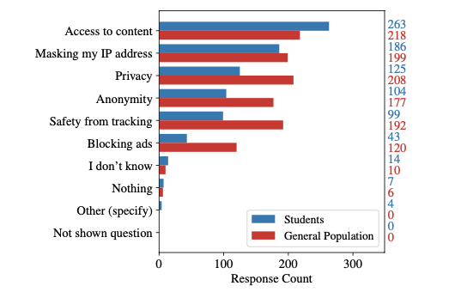
Findings:
What do you think your VPN guarantees? (responses selected by participants)
Notes:
When it comes to subjective feelings of our participants, the general poulation survey respondents believed that VPNs guarantee not only access to content (218/348), but also privacy, (208/348), safety from tracking (192/348), and anonymity (177/348).

Slide 40
Findings:
What do you think your VPN guarantees? (responses selected by participants)
Notes:
While student respondents generally did not feel that VPNs provided total anonymity but definitely guaranteed access to content.

Slide 41


Findings
VPN Usage
Mental Models of VPNs
VPN Selection
Notes:
Let's look at how participants selected VPNs

Slide 42




Findings
Main factors, when choosing a VPN
First use: Highschool/College
VPN Selection
Notes:
our main takeaways here are that All participants choose VPNs based on cost, security, and speed.
Participants from both groups learned about VPNs around high school and college

Slide 43
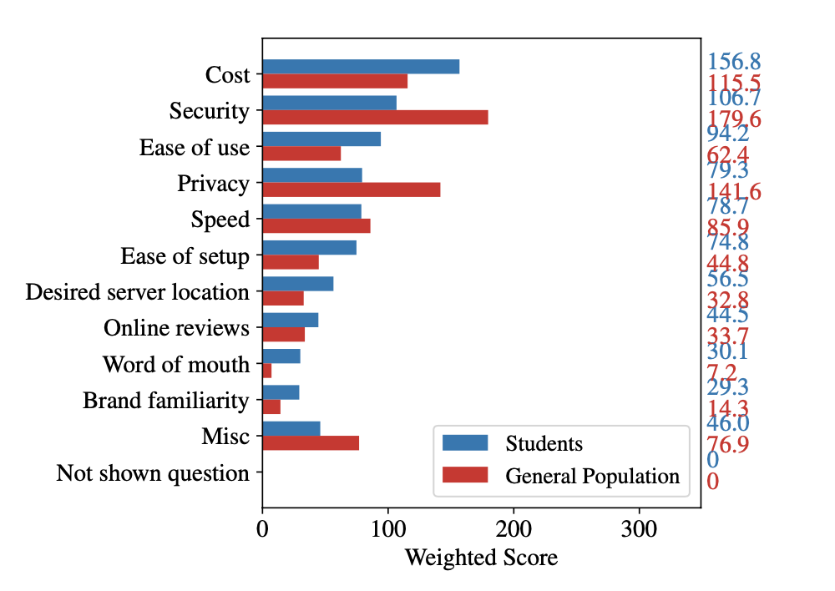
Findings:
Rank the five most important factors when choosing a VPN.
Notes:
Figure 12 breaks down what considerations were important when choosing between VPNs. The general population respondents considered security and cost to be important considerations when choosing which VPN to use. Privacy was a more important consideration than ease of use for the general population. This is consistent with our other finding that the general population often describes VPN functionality in terms of privacy and security. Student respondents' most important considerations when choosing between VPNs were cost, security, and ease of use (Figure 12). So slightly different. but both groups looked at the speed of VPNs as well.

Slide 44
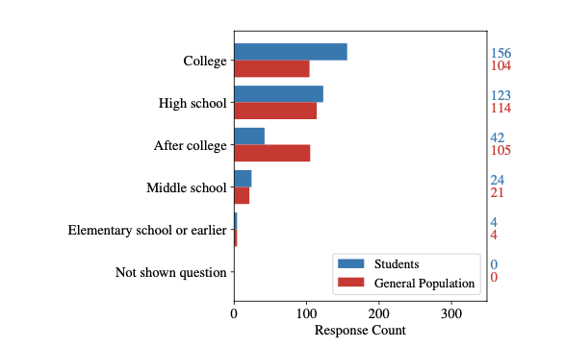
Findings:
When did you first use a VPN? (response selected by participants)
Notes:
. Lastlyhere we can see that our participants started to use VPNs around high school and college.

Slide 45
Introduction to VPNs
Methods
Findings
Implications
Conclusions
+
Plan
Notes:
what are the implications of our findings

Slide 46
Implications
VPN
Better Resources and Tools
VPN = ?
Privacy Equity
Other Technologies?
Notes:
and looking at other privacy-enhancing technologies, including private-browsing mode on common browsers or with Tor and see whether user attitudes and awareness match
or translate into those

Slide 47
Introduction to VPNs
Methods
Findings
Implications
Conclusions
+
Plan
Notes:
to conclude

Slide 48
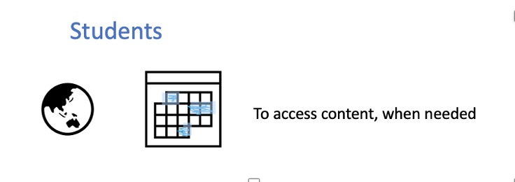
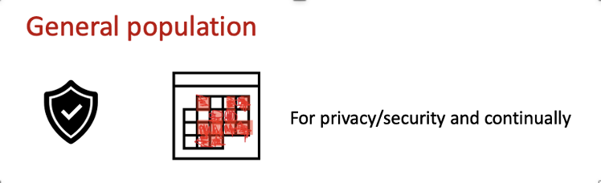
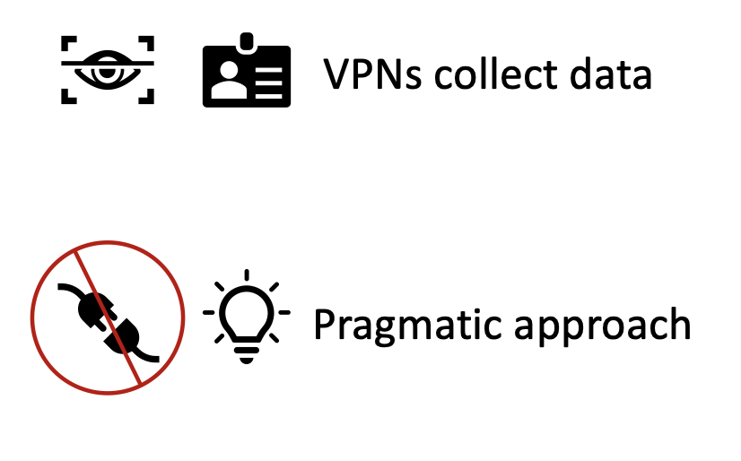
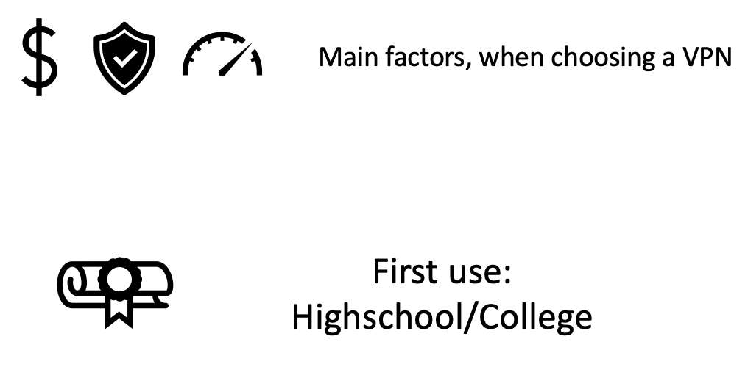
Conclusions!
Notes:
Students mostly used VPNs to access content and when needed while, general population use it more continuasly and for privacy and security. Our participants from both groups believed that VPNs can collect data and they had pragmatic approach towards VPNs. They also chose CPNs based on cost, security and speed and they started to use it around highschool and college.

Slide 49
Internet Censorship and Online Speech Chapter 5.2: Tor
Nick Feamster University of Chicago

Slide 50
Chaum’s Mix (1981)
Early proposal for anonymous email
David Chaum. “Untraceable electronic mail, return addresses, and digital pseudonyms”. Communications of the ACM, February 1981.
Public-key crypto + trusted re-mailer (Mix)
Untrusted communication medium
Public keys used as persistent pseudonyms
Modern anonymity systems use Mix as the basic building block

Slide 51
Basic Mix Design
A
{r₁,{r₀,M}_{pk(B)},B}_{pk(mix)}
{r₀,M}_{pk(B)},B
B
Mix
{r₅,M’’}_{pk(B)},B
C
{r₂,{r₃,M’}_{pk(E)},E}_{pk(mix)}
E
{r₃,M’}_{pk(E)},E
D
Adversary knows all senders and
all receivers, but cannot link a sent
message with a received message
{r₄,{r₅,M’’}_{pk(B)},B}_{pk(mix)}

Slide 52
Mix Cascades & Mixnets
Mix
Mix
Messages are sent through a sequence of mixes
Can also form an arbitrary network of mixes (“mixnet”)
Some of the mixes may be controlled by attacker, but even a single good mix ensures anonymity
Pad and buffer traffic to foil correlation attacks

Slide 53
Disadvantages of Basic Mixnets
Public-key encryption and decryption at each mix are computationally expensive
Basic mixnets have high latency
Ok for email, but not for Web browsing
Motivation: low-latency anonymity network
Use public-key crypto to establish a “circuit” with pairwise symmetric keys between hops
Then use symmetric decryption and re-encryption to move data along the established circuits

Slide 54


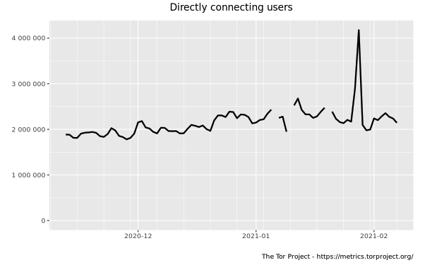
Second-generation onion routing network
https://torproject.org/
Specifically designed for low-latency anonymous Internet communications (e.g., Web browsing)
Running since October 2003
Hundreds of nodes on all continents
Over 2,500,000 users
“Easy-to-use” client
Freely available, can use it for anonymous browsing

Slide 55

The Tor Project
Main software: an onion routing protocol/tool to evade surveillance
Originally sponsored by the US Naval Research Laboratory.
From 2004 to 2006 was supported by EFF
Since 2006 has been 501(c)(3) nonprofit

Slide 56
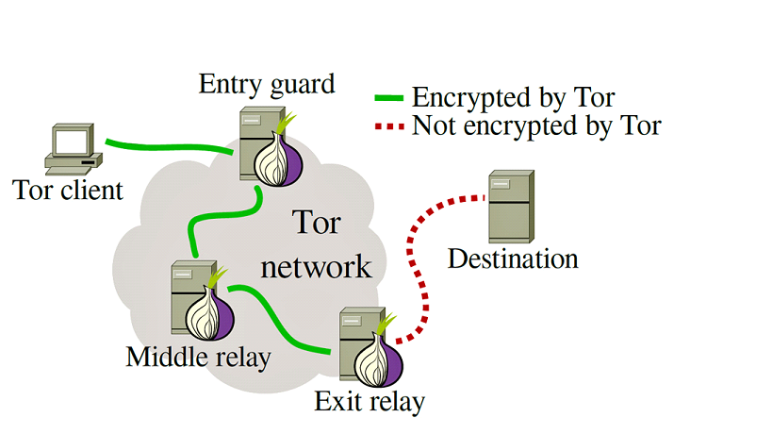
Tor
Route traffic through sequence of “onion” relay nodes.

Slide 57
So How Does an Onion Routing Protocol Work?
The user creates a “circuit” leading to their destination.
At each hop, the node “unwraps” a layer from the packet via symmetric keys, revealing the next destination.
Full technical details: https://www.torproject.org/tor-design.pdf

Slide 58
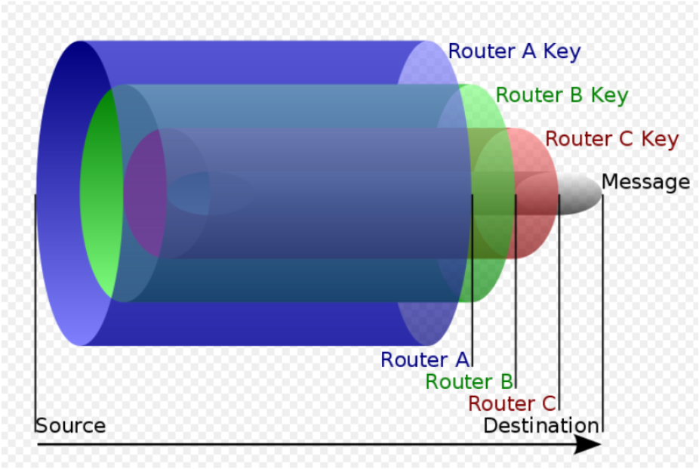
Onion Encryption

Slide 59
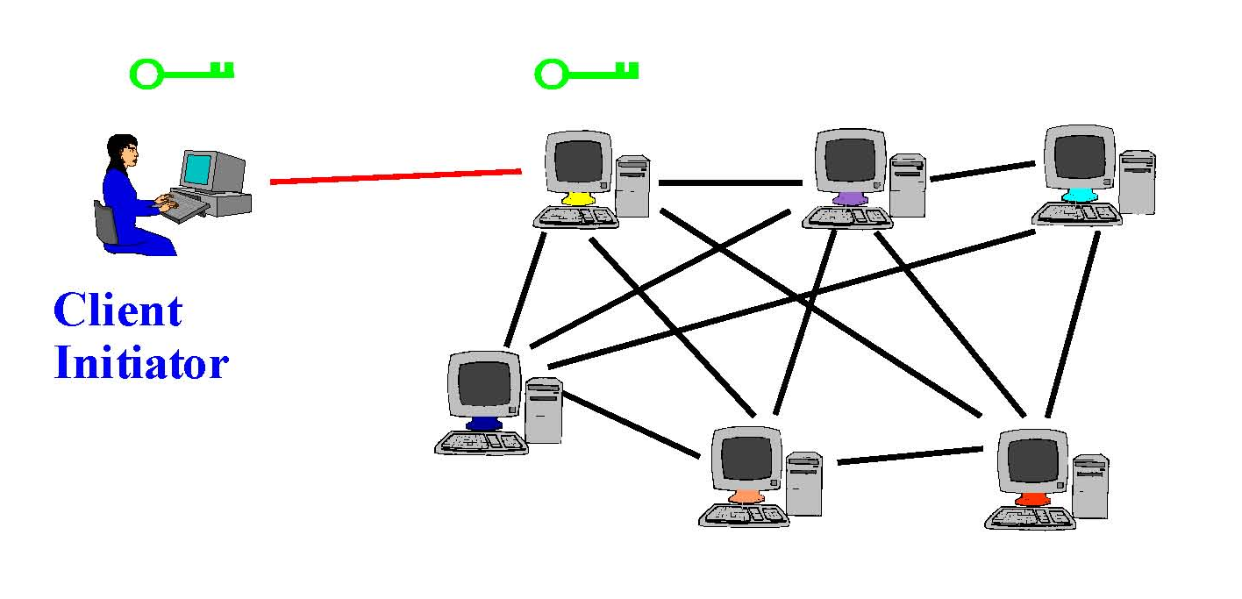
Tor Circuit Setup: Step 1
Client proxy establishes a symmetric session key and circuit with Onion Router #1

Slide 60
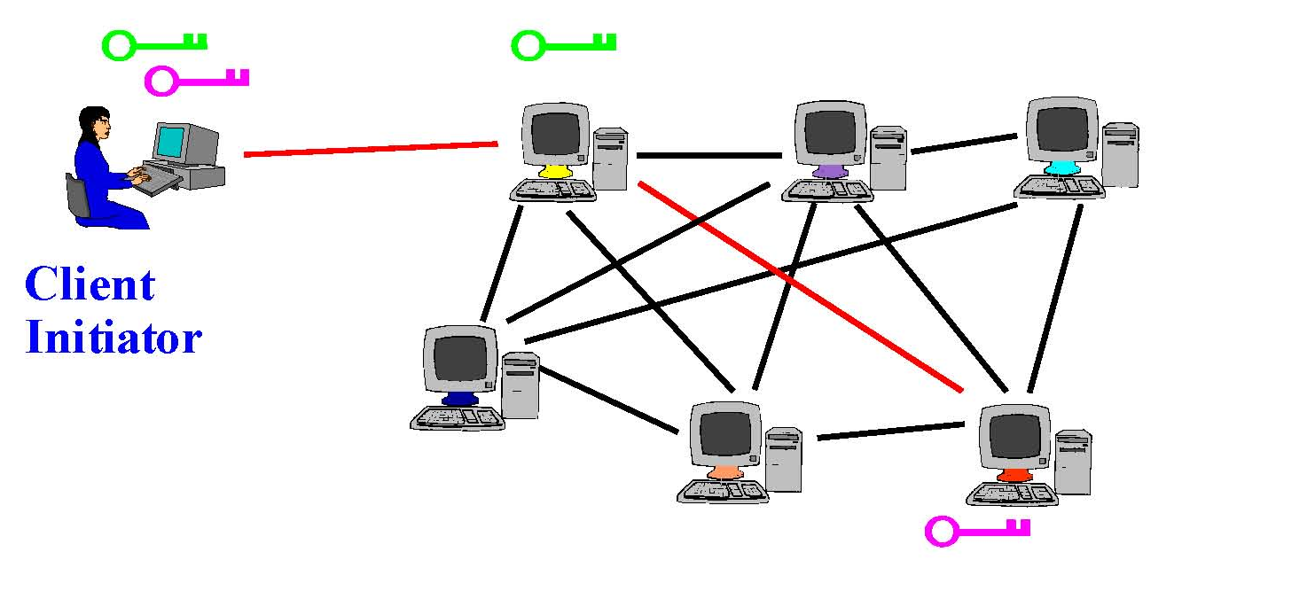
Tor Circuit Setup: Step 2
Client proxy extends the circuit by establishing a symmetric session key with Onion Router #2
Tunnel through Onion Router #1

Slide 61

Tor Circuit Setup: Step 3
Client proxy extends the circuit by establishing a symmetric session key with Onion Router #3
Tunnel through Onion Routers #1 and #2

Slide 62
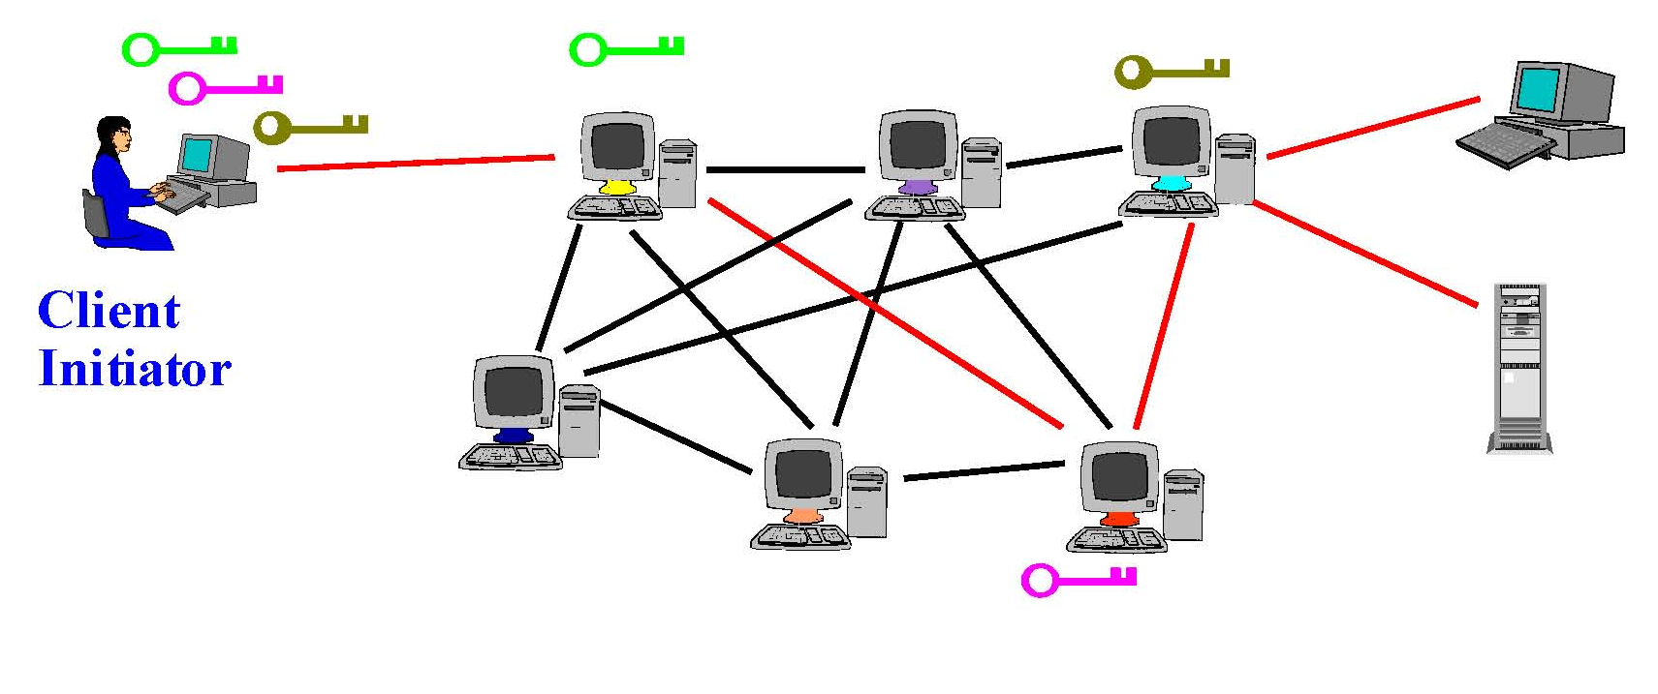
Using a Tor Circuit
Client applications connect and communicate over the established Tor circuit
Datagrams decrypted and re-encrypted at each link

Slide 63





Using Tor Circuits
Clients begin all circuits with a selected guard
Relays define individual exit policies
Clients multiplex streams over a circuit
New circuits replace existing ones periodically

Slide 64
Tor Management Issues
Many TCP connections can be “multiplexed” over one anonymous circuit
Directory servers
Lists of active onion routers, their locations, current public keys, etc.
Control how new routers join the network
“Sybil attack”: attacker creates a large number of routers
Directory servers’ keys ship with Tor code

Slide 65
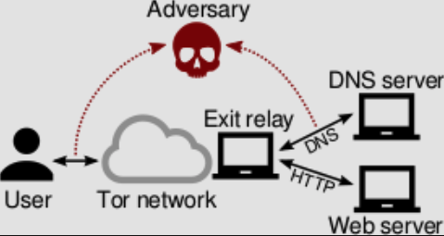
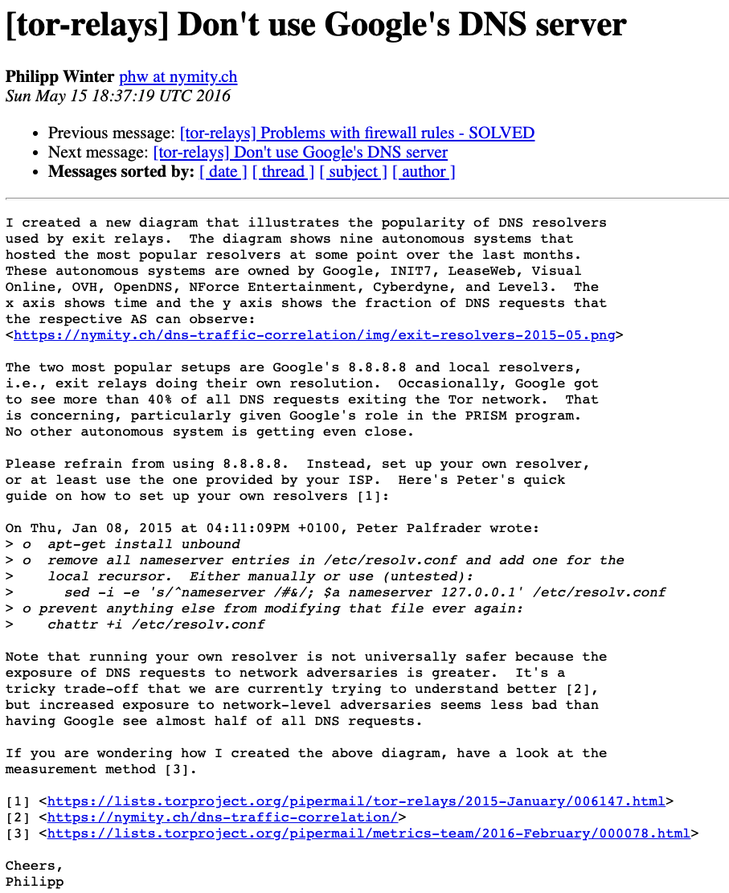
Threats to Privacy in Tor
Traffic analysis
Website “fingerprinting”
Timing analysis: linking sender and receiver
DNS leaks: DNS traffic may not go through Tor, or may be observable from the exit node
Rogue exit nodes

Slide 66


Node-Level Adversaries

Slide 67

Link-Level Adversaries
Some ASes and IXPs
handle much more
traffic than others!
AS8
AS6
AS6
AS7
AS1
AS2
AS3
AS4
AS5
Adversary has fixed location, may control one or more
autonomous systems or Internet exchange points (IXP)

Slide 68
Summary
Tor is a multi-hop network designed for anonymous communication
Draws inspiration from Mix networks, but designed for low latency
More than two million users
Many people also use it for censorship circumvention (and other purposes)
Many of the attacks against Tor involve traffic analysis and blocking of access to “guard” nodes

Slide 69
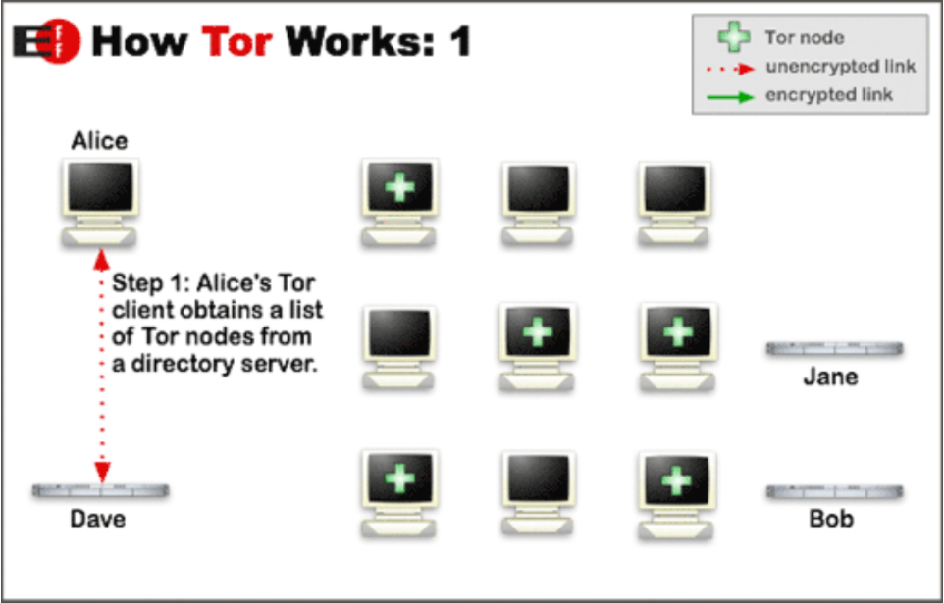

Slide 70
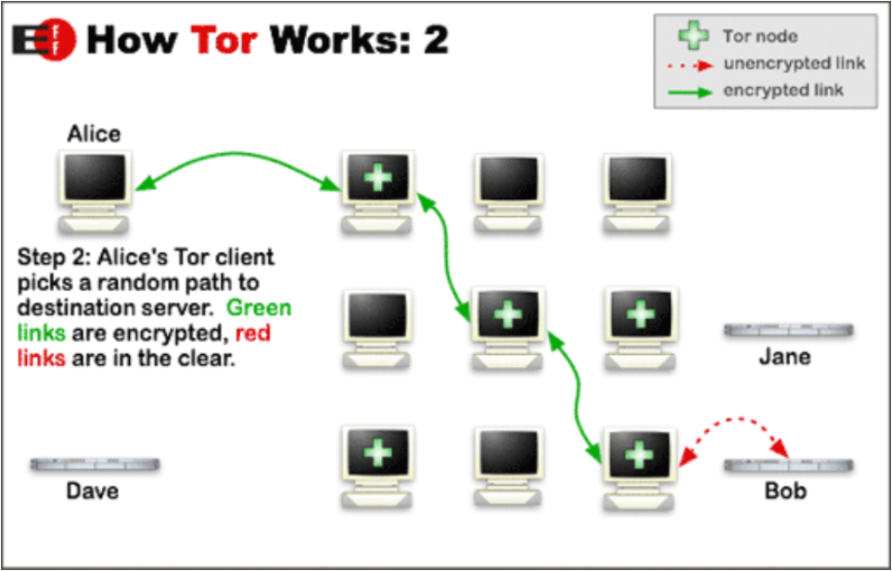

Slide 71
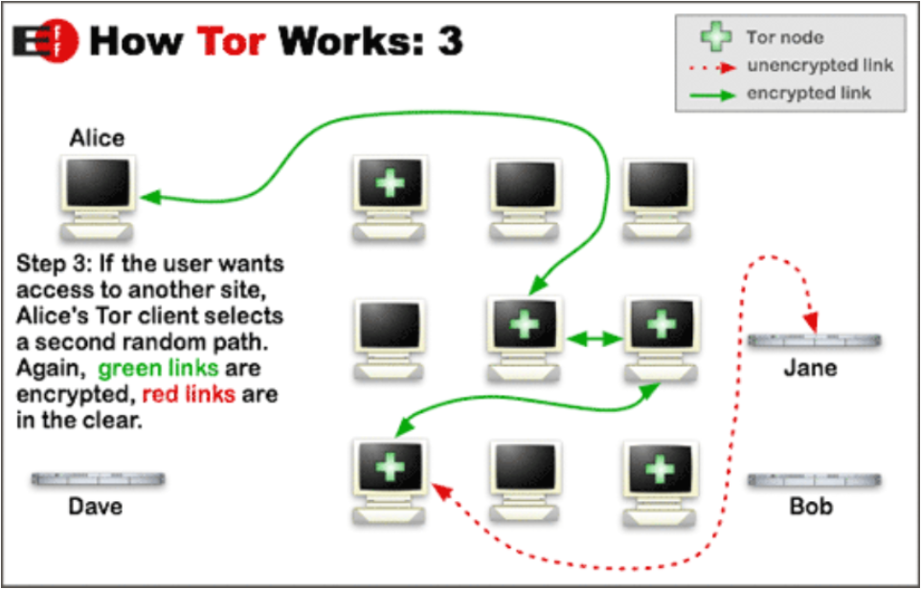

Slide 72
Internet Censorship and Online Speech Chapter 5.3: Pluggable Transports
Nick Feamster University of Chicago

Slide 73
Pluggable Transports
Problem: Deep Packet Inspection (DPI) can allow a censor to discover and block Tor traffic
Solution: Make traffic look like something else
Tor calls this approach “pluggable transports”
Currently deployed pluggable transports:
Meek: https://gitlab.torproject.org/legacy/trac/-/wikis/doc/meek
Obfs4: https://github.com/Yawning/obfs4/blob/master/doc/obfs4-spec.txt
Format-Transforming Encryption (FTE): https://fteproxy.org/
ScrambleSuit: https://www.cs.kau.se/philwint/scramblesuit/
Notes:
To disguise easily identifiable traffic patterns, transports take two main approaches: obscuring the traffic patterns randomly, or mimicking existing protocols.

Slide 74
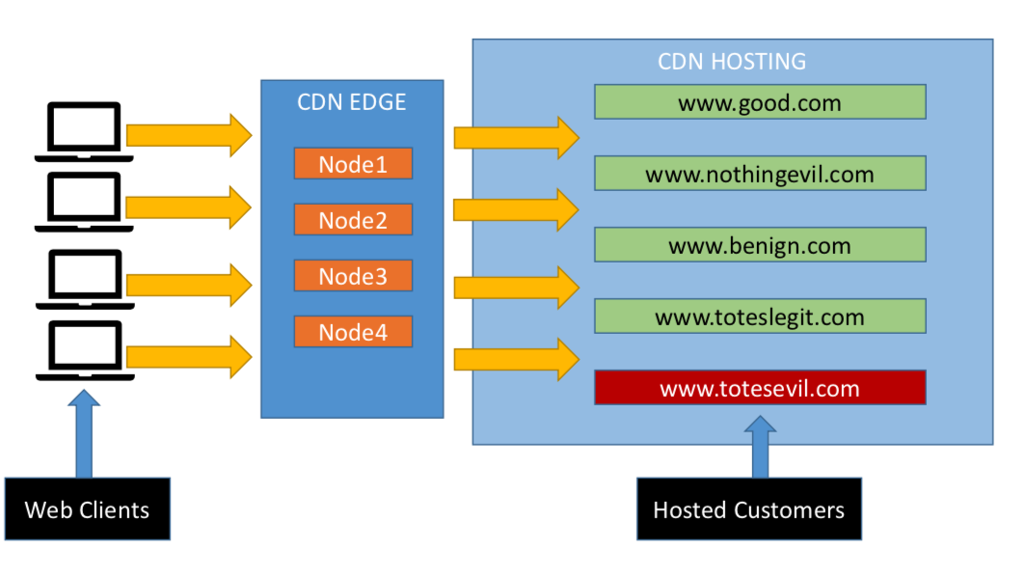
Meek: Domain Fronting
Notes:
Meek [10] is a recently proposed system that relies on an innovative technique called domain fronting to hide the true destination of a client’s traffic. Unlike existing pluggable transports, Meek traffic appears to the censor to be heading to a legitimate, allowed website. The censored, covert destination (typically a proxy running on the same cloud service as the allowed website) is instead hidden in the Host: header field of the HTTP header to the allowed site. Destination information appears in three different places in an HTTPS request: the IP address, the TLS Server Name Indication (SNI) extension, and the Host header of the HTTP request. While the first two are viewable by a censor or any router between the client and the destination, the HTTP request is encrypted with all other application data after the completion of the TLS handshake. Domain fronting is the practice of specifying one domain, usually an edge server for a cloud service, in the IP address and SNI fields, while setting the encrypted HTTP host header to a different domain.

Slide 75
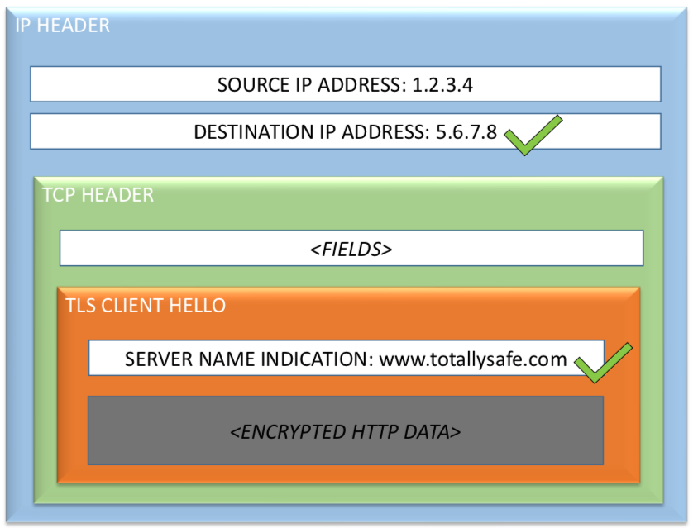
Meek: Domain Fronting
Notes:
Meek [10] is a recently proposed system that relies on an innovative technique called domain fronting to hide the true destination of a client’s traffic. Unlike existing pluggable transports, Meek traffic appears to the censor to be heading to a legitimate, allowed website. The censored, covert destination (typically a proxy running on the same cloud service as the allowed website) is instead hidden in the Host: header field of the HTTP header to the allowed site.
Destination information appears in three different places in an HTTPS request: the IP address, the TLS Server Name Indication (SNI) extension, and the Host header of the HTTP request. While the first two are viewable by a censor or any router between the client and the destination, the HTTP request is encrypted with all other application data after the completion of the TLS handshake. Domain fronting is the practice of specifying one domain, usually an edge server for a cloud service, in the IP address and SNI fields, while setting the encrypted HTTP host header to a different domain.

Slide 76
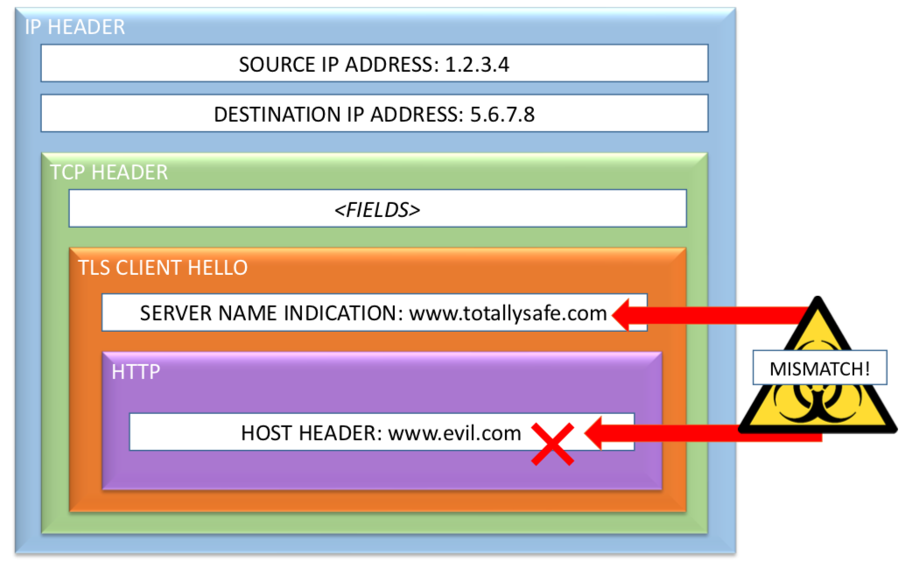
Domain Fronting: What Servers See

Slide 77
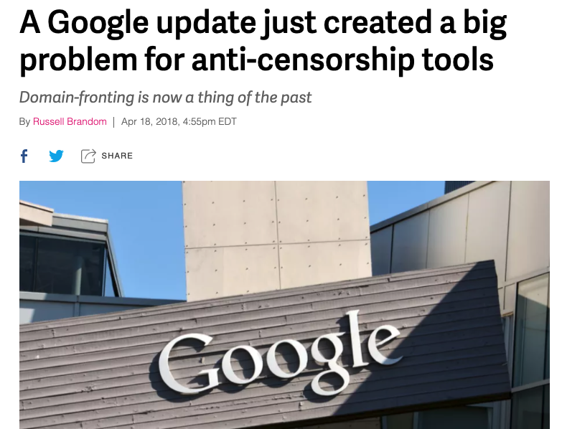
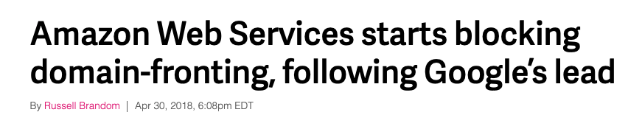
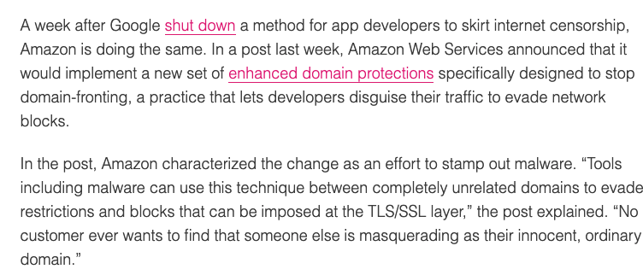
Domain Fronting in Practice
Proxy Networks
Tor (via Meek “pluggable transport”), Psiphon, Lantern, …
Messaging
Signal, Telegram, …

Slide 78
Summary
Censors can detect and block circumvention tools
Thus, the tools themselves need ways to obfuscate or disguise parts of their traffic that are most identifiable
Tor has a suite of “pluggable transports” that provide this functionality
Pluggable transports can themselves be blocked!

Slide 79
Internet Censorship and Online Speech Chapter 5.4: Steganography and Covert Channels
Nick Feamster University of Chicago

Slide 80
Steganography: Overview
Goal: Hide the existence of any communication
Methods: Make one form of traffic look like another
Challenges: Performance, traffic analysis attacks

Slide 81
Steganography: Requirements
Client deniability
Detection could be embarrassing or worse
Client statistical deniability
Even suspicion could be a problem
Server covertness/statistical deniability
If server detected, can be blocked
Communication robustness
Even without detecting, censor could scramble covert channel
Performance (bandwidth, latency)

Slide 82
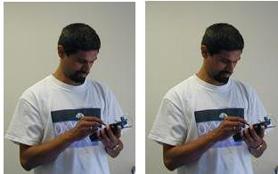
Example
One image has embedded content
You can’t tell which (shows it’s working)

Slide 83
Untrusted Responders
Only a few, trusted responders
Forwarders mediate requestor/responder discussion, but do NOT know secretly requested content (or even if content being requested)
But delay added on every transaction

Slide 84
Receiving Content: Easier
Responder is a normal web server, serving images (among other things)
Encrypt data using requestor key
Embed in “unimportant, random” bits of images
E.g., high order color bits
Watermarking
Encrypted data looks random---only requestor can tell it isn’t (and decrypt)

Slide 85
Upstream (Requests) is Harder
No “random content bits” that can be fiddled to send messages to responder
Solution: let browsing pattern itself be the message
Suppose web page has k links.
GET on i^{th} link signifies symbol “i” to requestor
Result: log₂(k) message bits from link click
Can be automated
To prevent censor from seeing message, encrypt with responder key

Slide 86
Higher Performance
Idea: arithmetic coding of requests
If request i has probability p_{i}, then entropy of request distribution is –Σ p_{i} log p_{i}
Arithmetic coding encodes request i using log p_{i} bits
Result: expected request size equals entropy
Optimal
Problem: requestor doesn’t know probability distribution of requests
Doesn’t have info needed for encoding

Slide 87
Solution: Range Mapping
Adler-Maggs
Exploit asymmetric bandwidth
Responder sends probability distribution to requester using easy, downstream path
Requestor uses this “dictionary” to build arithmetic code, send encoded result
Variation for non-binary
Our messages aren’t bits, they are clicks
And server knows different clicks should have different probabilities

Slide 88
Toy Example
Suppose possible requests fewer than links on page
Responder sends dictionary:
“link 1 means http://mit.edu”
“link 2 means http://stanford.edu”
Assigns common requests to common GETs
Requestor GETs link matching intended request
One GET sends full (possibly huge) request
Problem: in general, ∞ possible requests
Can’t send a dictionary for all

Slide 89
Generalize: Twenty Questions
Order all strings lexicographically
Identify “split string” such that
Strings up to split have total probability <1/2
Strings after split have total probability <1/2
Responder sends split string
Requestor sends 0/1 as desired request precedes/follows split string
Recurse on half of distribution selected
Result: requestor sends O(entropy) bits

Slide 90



Can We Do This Without Dedicated Infrastructure?
usenix.org
Unblocked host
Firewall
Alice
Bob
Censored net
Uncensored net
Not entirely robust against blocking
More deniable because messages are hidden
Requires dedicated infrastructure (Web servers)
Notes:
“Another approach is for Alice to establish a covert channel. One system that does this is Infranet, where a site like usenix.org hides messages from Bob its Web pages. When Alice uses Infranet, it appears that she is just browsing USENIX’s Web site, while in fact she is also receiving Bob’s messages. This system is nice because it prevents the censor from identifying users, but it still faces deployment hurdles and may be easily identified and blocked unless adopted by popular Web sites.”

Slide 91





Collage: Let User-Generated Content Help
User-generated content hosts
Alice
Bob, a Flickr user
Robust by using redundancy
Users generate innocuous-looking traffic
No dedicated infrastructure required
Notes:
“To meet our design goals, we have built Collage, which uses user-generated content to help circumvent censorship firewalls. To the best of our knowledge, Collage is the first system to satisfy all three of the design goals I have proposed.”
“Here is an example of how Collage works. Suppose Bob has an account on the popular photo-sharing site Flickr and has a fresh batch of photos that he wants to upload. Before uploading his photos, he fetches the blocked content for Alice, then hides it inside his photos. Afterward, he uploads these photos to Flickr. Later, Alice goes to Flickr, downloads the photos and extracts the content from them.”
“The first thing to notice is that Collage requires no dedicated infrastructure. Photos are stored on Flickr, which is an existing content host that already serves millions of photos every day.”
“Secondly, notice that both Alice and Bob generate plausible traffic. Bob uploads photos to Flickr just as he always would, and Alice simply browses Flickr and downloads some photos.”
“Note that although I used Flickr for this example, Bob could just as well use Collage with another content host like YouTube.”

Slide 92
Why Might Collage Work?
Lots of User-Generated Content (UGC)
More than 4 billion Flickr images
A day of video uploaded to YouTube every minute
Many sites host UGC
We have tools to store censored data in UGC
Steganography, watermarking
Notes:
“You may be skeptical that Collage can work in practice. There are several reasons to believe that it can.”
“First, there is a massive amount of user-generated content available. Flickr has over 4 billion images and an entire day of video is uploaded to YouTube every minute.”
“Second, there are many sites that host user-generated content. Aside from the famous examples like Flickr and YouTube, there are many blogs and forum sites that Collage could use. All the content could potentially serve an additional purpose by holding censored data”
“Finally, we do in fact have existing tools for hiding data inside user-generated content. These technologies are steganography and watermarking, which I’ll discuss later.”

Slide 93
Collage, Step-by-Step
Embedded Vector
Vector
Message
Alice
Bob
Collage steps:
Obtain message
Pick message identifier
Obtain cover media
Embed message in cover
Upload UGC to content host
Find and download UGC
Decode message from UGC
Content host
Step 2: Pick message identifier
Application specific
Only intended recipient should know it
Step 3: Obtain cover media
Your personal photos
Generous users
Step 5: Upload UGC to content host
Step 7: Decode message from UGC
Step 1: Obtain message
Step 4: Embed message in cover
Next slide
Step 6: Find and download UGC
Notes:
“Ok, now I’m going to quickly take you through how Collage works step by step. After I’ve given you a general idea, I’ll go into detail on several steps.”
“So, suppose that Bob wants to send a message to Alice. The first thing he does is figure out what message he wants to send. For example, if he wants to send her a censored Web page he’ll fetch that Web page.”
“Next, Bob chooses a message identifier. I’ll discuss the specifics of this later in the talk, but briefly, the identifier is known only by Alice and Bob, and is used to agree on where Alice will find Bob’s message.”
“After picking the identifier, step 4 is to get some cover media. For example, some pictures from Bob’s digital camera. For the remainder of the talk, we are going to refer to any user-generated media as vectors, to convey the fact that they can hold censored data.”
“He then hides the message inside these vectors, which I go over in the next slide.”
“After the message is embedded inside the vectors, Bob uploads the vectors to a content host and Alice fetches these vectors from the content host. I’ll discuss this details of these steps in a few minutes.”
“After Alice has Bob’s vectors, she reverses the embedding process that Bob performed in step 4 and recovers the message.”
“Ok, so I’m now going to give you more detail on several of these steps.”

Slide 94
Embedding Messages in Vectors
Encrypt the message using the identifier
Generate chunks using erasure coding
Generate many chunks, recover from any k-subset
Allows splitting among many vectors, robustness
Embed chunks into vectors
Collage steps:
Obtain message
Pick message identifier
Obtain cover media
Embed message in cover
Upload UGC to content host
Find and download UGC
Decode message from UGC
Steganography: hard to detect
Watermarking: hard to remove
Do the reverse to decode
Notes:
“First I’m going to discuss how Bob embeds his message into his vectors.”
“First, he encrypts the message using the message identifier. Because we assumed that only Alice and Bob know the identifier, this prevents adversaries from recovering the message.”
“Next Bob runs the message through a rateless erasure coder. This will generate a large set of chunks, such that Alice can retrieve any smaller subset of these chunks and reconstruct the original message. For example, Bob might generate a thousand chunks, but Alice might only need 50 of them to recover the message.”
“Next, Bob embeds chunks into his vectors using information hiding techniques. The goal of this step is to store the chunks inside the vectors without visibly changing the cover vector. With steganography, the goal is to hide the existence of chunks, while in watermarking it is to make these chunks difficult to remove. I emphasize that the purpose of using information hiding is to store censored data into the vectors.”
“In step 7, after Alice downloads the vectors she performs the reverse operations to recover the message.”
“The nice thing to notice about this scheme is that by using erasure coding, we ensure a level of robustness, since Alice will only need to obtain some subset of Bob’s vectors in order to recover the message.”

Slide 95
Where Are Bob’s Vectors?
Crawling all of Flickr is not an option
Must agree on a subset of a content host without any immediate communication
Solution: A predictable way of mapping message identifiers to subsets of content hosts
Collage steps:
Obtain message
Pick message identifier
Obtain cover media
Embed message in cover
Upload UGC to content host
Find and download UGC
Decode message from UGC
Notes:
“Now, going back to Bob, after he embeds the message in his vectors, he uploads them to a content host. The question now is how does Alice find these vectors. It’s not as simple as it might sound. Without guidance, she might have to crawl the entire content host, or even several content hosts, before finding Bob’s vectors. Clearly, that’s impractical.”
“The solution is an algorithm that Bob and Alice can use to identify a small subset of a content host.”

Slide 96
Solution: Task Mapping
Tasks
Message Identifier
1
Hash the identifier
Hash the tasks
Map identifier to closest tasks
http://nytimes.com
11
Receivers perform these tasks to get vectors
Senders publish vectors so that when receivers perform tasks, they get the sender’s vectors
11
Search for blue flowers on Flickr
9
9
3
Look at JohnDoe’s videos on YouTube
Collage steps:
Obtain message
Pick message identifier
Obtain cover media
Embed message in cover
Upload UGC to content host
Find and download UGC
Decode message from UGC
Tasks
6
Notes:
“Our algorithm is called task mapping. It produces a list of actions, which we call tasks, that specify a set of vectors on the content host.”
“To begin, we hash the message identifier. For example, the message identifier nytimes.com might hash to 1. Next, assuming that Alice and Bob both have a collection of tasks, we get the hashes of each task. We hash the identifier and the tasks to the same message space, so we can map the message identifier to a set of tasks by, for example, picking the next two tasks in the space.”
“These tasks are actions that Alice can perform to get some vectors on the content host. For example, a task might be to search for blue flowers on Flickr.”
“Bob must upload vectors so that Alice will find them when she performs these tasks. Therefore, if Alice searches for pictures of blue flowers on Flickr, then Bob should upload pictures of blue flowers.”
“Ok, so to recap, if Bob wants to send Alice a message using Collage, he picks a message identifier and embeds the message into a set of vectors using erasure coding and information hiding. He then performs task mapping using the message identifier to discover where to upload the vectors. After he’s uploaded them, Alice will also perform task mapping to get a set of tasks that will yield Bob’s vectors.”

Slide 97


How Does Collage Meet the Design Goals?
Robust against blocking
Erasure coding
Many content hosts
Deniable against user identification
Traffic only to/from content hosts
Depends upon task construction
Require no dedicated infrastructure
Messages stored on content hosts
Notes:
“Let’s take a step back and see if Collage meets the design goals I proposed at the beginning of the talk.”
“First, because Collage uses erasure coding and an assortment of content hosts, messages are robust to blocking. Even if a censor blocks some vectors and content hosts, receivers can recover the message by fetching the remaining vectors from the remaining content hosts.”
“Second, at least at first glance Collage users generate deniable traffic because they only upload and download content from user-generated content hosts. However, the real-world deniability depends a lot on the types of tasks they perform and how frequently they perform them. Specifically, we provide a framework with which you can construct deniable applications.”
“Finally, Collage relies on user-generated content hosts to store transfer messages and so requires no dedicated infrastructure.”

Slide 98
How Do You Start Using Collage?
Send & Receive Messages
Help Censored Users
Distribute software
CDROM
Spam everyone
A secure network
Refresh task list
Receive using Collage
Online resource
Message identifier
Application specific
Donate your UGC vectors
Photos on Flickr
Tweets on Twitter
Etc.
Write Collage applications
Notes:
“So you may be wondering how users actually begin using Collage.”
“If a users want to send messages using Collage, they must get a hold of the Collage software. They must do this out of band, such as from a CD, from Spam e-mail, by bringing their computer to a secure network.”
“Because content hosts are dynamic by nature, users may also periodically need to update their list of tasks as tasks become invalid or new tasks become available. They might receive these updates using Collage itself or they could derive their tasks from some online resource such as a publically available list of popular search terms.”
“Finally, as we said before, Alice and Bob must agree on a message identifier for each message. There are application-specific algorithms for agreeing on message identifiers ahead of time. For example, using the date or a rotation scheme. We discuss this much more in the paper.”

Slide 99
Performance Metrics
Sender and receiver traffic overhead
Sender and receiver transfer time
Storage required on content hosts
But these metrics can vary a lot:
Different content hosts
Different tasks
Different applications
Notes:
“We care about three performance metrics for collage: The traffic overhead and overall transfer times required by Alice and Bob, and the amount of storage required on content hosts.”
“Unfortunately, I can’t give you concrete numbers for these metrics in the general case because the implementation details of each application and content host vary so widely.”
“Instead, I’ll show you performance metrics for two example applications.”

Slide 100
Case Study
 | News Articles | Covert Tweets
Content host | Flickr | Twitter
Message size | 30 KB | 140 Bytes
Vectors needed | 5 | 30
Storage needed | 600 KB | 4 KB
Sending traffic | 1,200 KB | 1,100 KB
Sending time | 5 minutes | 60 minutes
Receiving traffic | 6,000 KB | 600 KB
Receiving time | 2 minutes | ½ minute
Experiments performed on a 768/128 Kbps DSL connection
Notes:
“The first application embeds news articles inside photos hosted on Flickr. For a 30 kilobyte message, we require 5 photographs and use about 7 megabytes of traffic over 6 minutes. A main cause of the large overhead for Flickr are extra advertisements and photo thumbnails.”
“The second application stores covert tweets inside other tweets on Twitter. To send a single 140 byte message, we need 30 tweets and under 2 megabytes of traffic. We spread out the posting of these tweets over the span of an hour to more closely approximate real Twitter usage.”
“These two applications give a idea of the performance you can expect from Collage. The take home message here is that Collage applications can have reasonable performance even if the capacity of the message channel itself is very limited.”
“I’m now going to show a demo of the first application, which publishes BBC news articles inside photos hosted on Flickr.”

Slide 101
Comparison to Other Systems
Technique | System | Robustness | Deniability | Infrastructure
Onion routing | Tor | Layered encryption; bridges | Encryption | Network of relay servers
Anonymous remailing | Mixminion | Many hops; mixing | Encryption | Network of remailers
Covert channels | Infranet | Could use many proxy forwarders | Browsing regular Web sites; Steganography | Custom Web servers
 | CovertFS | Multiple content hosts | Browsing regular Web sites; Steganography | None
 | Collage | Erasure coding; Many content hosts | Browsing content hosts; Info hiding | None

Slide 102
Imitating a Real System Is Hard
Not enough to mimic a "protocol," need to mimic
a specific implementation with all its quirks
A complex protocol in its entirety
Inter-dependent sub-protocols with
complex, dynamic behavior
Bugs in specific versions of the software
User behavior

Slide 103


Slide 104
Summary
Information hiding (steganography and covert channels) can be used to evade censorship detection and blocking
These techniques often have quirks that make them detectable
They perturb the original content
They don’t behave like the original (“The parrot is dead.”)
They are also often fairly low bandwidth

Slide 105
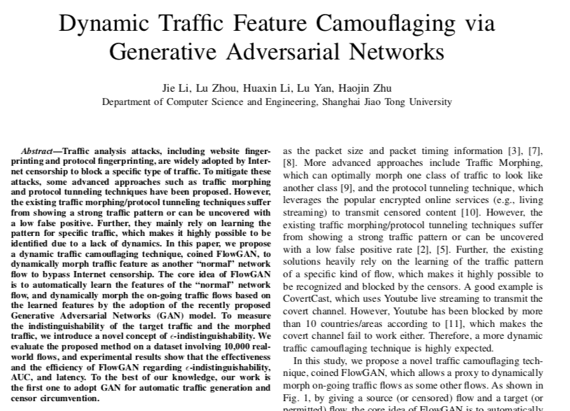
Looking Ahead: Generative Adversarial Networks?

Slide 106
Internet Censorship and Online Speech Chapter 5.5: Decoy Routing
Nick Feamster University of Chicago

Slide 107
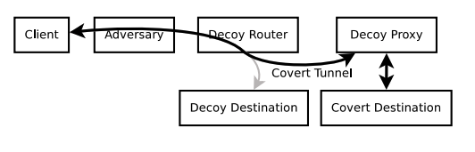
Decoy Routing
Decoy router can sit on any network path and act as a proxy (or forward client traffic to a decoy proxy).
But how can the client connect to the proxy?
Why can it not just address a packet to the proxy destination?
Solution: Connect to a decoy destination
Once connected covertly signal over TCP/IP flow that the decoy router should forward the packet to the proxy
Proxy then intercepts the TCP connection (drop connection to decoy destination) and act as a regular proxy.

Slide 108

Decoy Routing Timeline
Client starts connection as usual
Sends sentinel, which decoy proxy can see
Proxy resets connection to decoy and then commences proxying for client to covert destination

Slide 109
Various Decoy Routing Systems
Curveball (2011): Sentinel in cookie, HTTP field
Telex (2011): Sentinel in nonce of TLS ClientHello
Cirripede (2011): Similar design, uses registration in TCP SYN
Tapdance (2014): Asymmetric flows, left forward connection half-open
Rebound (2015): Added resistance to active adversarial attacks
Slitheen (2016): Resistance to traffic analysis through replacement

Slide 110

Advanced Decoy Routing: Passive ISP Monitoring
Client
ISP Proxy
Server
TLS Handshake
Plaintext:
Ciphertext:
“GET / HTTP/1.1\r\nX-Ignore: \x81\x28\x66 …”
“\x95\x1f\x6b\x27\xe2 … \xc8\x3f\x22 …”
Tag:
ACK [seq=Y, ack=X]
“PROXY OK” [seq=Y, ack=X, len=M]
Plaintext:
ACK [seq=X, ack=Y+M]
ack != Y?
Plaintext:
“GET http://blocked.com/ …” [seq=X, ack=Y+M]
“HTTP/1.1 200 OK … <html> ….”
Plaintext:

Slide 111
Decoy Routing: Pros and Cons
Decoy routing is an approach that diverts traffic to a destination via an in-network proxy
Pros
No inline blocking required, only passive tap
Recent systems work well with with asymmetric flows (client -> server)
Cons
Requires ISP cooperation/deployment
In some systems censor can use active attacks that definitively identify decoy routing (more recent systems attempt to address this shortcoming)

